Slide 1
COASTAL LANDFORMS
Embayments
Marine Terraces
Sea Stacks
Notes:
Sea stacks are especially common in Redwood National Park.

Slide 2
COMPARISON OF ACCRETIONARY WEDGES
PARK | AGE | SUBDUCTION RATE | SEDIMENATION RATE | COMPOSITION | COASTAL LANDFORMS
OLYMPIC | YOUNG | SLOW | HIGHEST | Turbidite, basalt, limestone, quartz veins | Marine terraces, stacks, arches, tombolos
REDWOOD | OLD | SLOW | HIGHER | MELANGE: (basalt, peridotite, chert, greywacke, argillite) | Marine terraces, stacks, arches, tombolos, drowned river valleys
KENAI FJORDS | MIDDLE | MODERATE | HIGH | HIGH Ophiolite, granite, mélange | Fjords, stacks, arches
Notes:
This is because a lot of different rock types were incorporated into the old accretionary wedge.

Slide 3
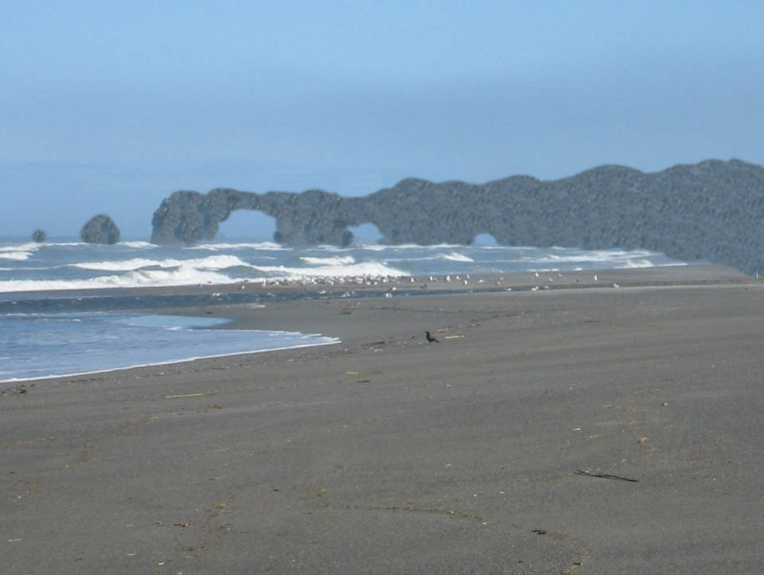
Rocky Point
softer rock
Notes:
So where rocky headlands jut into the turbulent surf zone, the softer rocks are eroded …

Slide 4
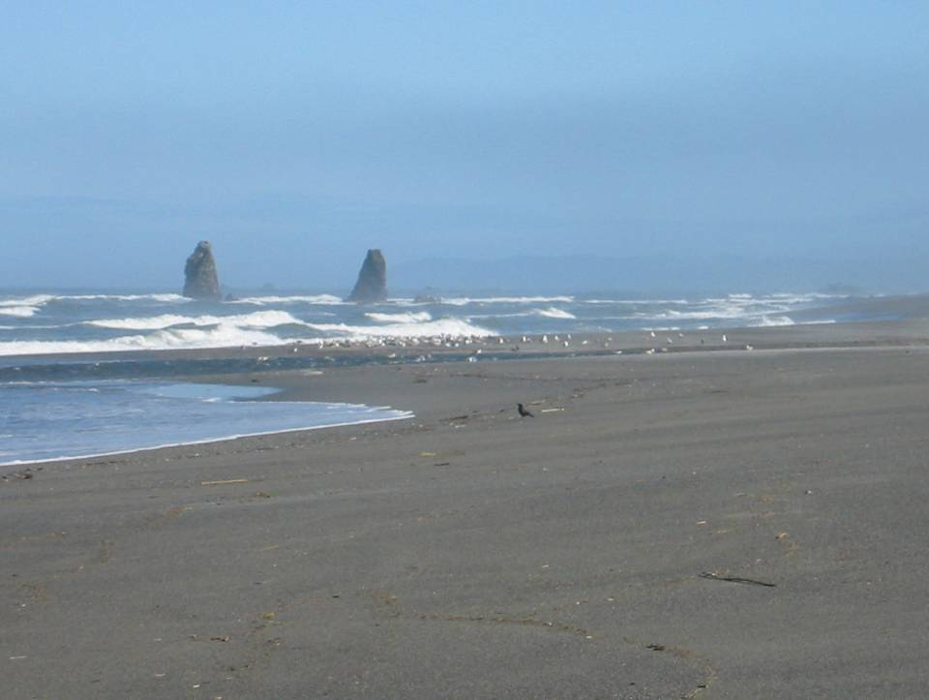
hardest rock
Can I move now?
Notes:
… and after thousands of years, only the hardest rocks remain to form sea stacks.

Slide 5
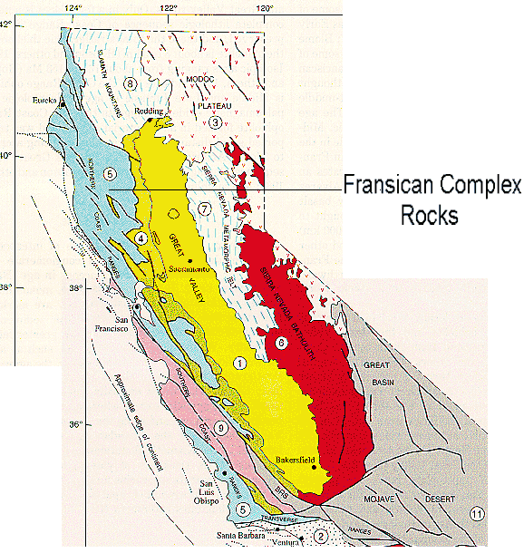
Franciscan Complex
Notes:
Virtually all of the bedrock in Redwood National Park is part of the signature rock unit of the Coast Ranges – the Late Jurassic to Cretaceous Franciscan Complex.

Slide 6
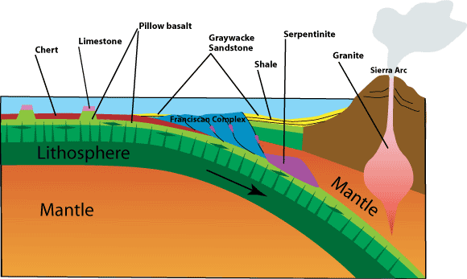
Notes:
Like the rocks in Olympic National Park, the Franciscan Complex basically represents accretionary wedge material, but unlike the Olympic wedge, the Franciscan is a far more complex mélange of diverse rock types and may contain as many as eight separate terranes.

Slide 7
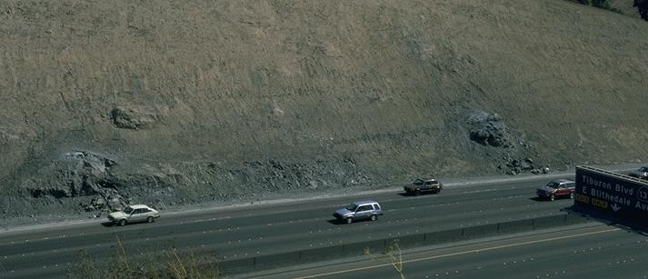
Franciscan mélange exposed in fresh road cut
Notes:
The various rock types are embedded within a matrix of highly sheared mudstone. This material is quick to erode, so it is difficult to find an intact unit to view. Here we see one of the few exceptions along a relatively recent Highway 101 road-cut through the mélange.

Slide 8
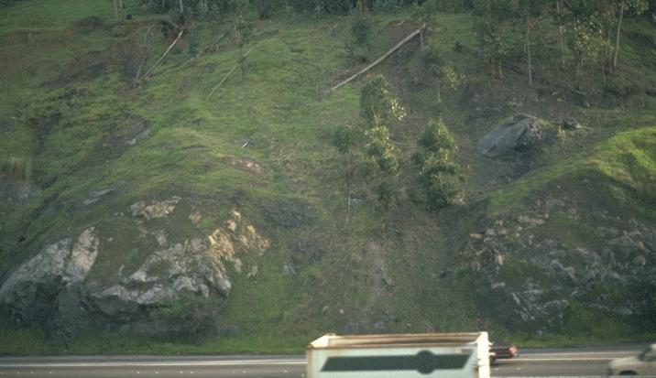
Franciscan mélange exposed in much older cut
Notes:
In this much older Highway 101 cut there has been substantial erosion of the loose material and the resistant masses are quite marked.

Slide 9
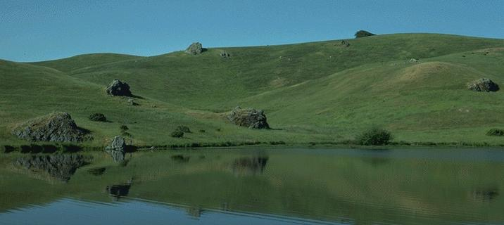
Massive greywacke or chert “knockers” in mélange
Notes:
Natural slopes of course have been exposed to erosion much longer. Here far more of the sheared and crushed material of the mélange is eroded. The erosion-resistant rock masses are called “knockers” and tend to be massive greywacke or chert.

Slide 10
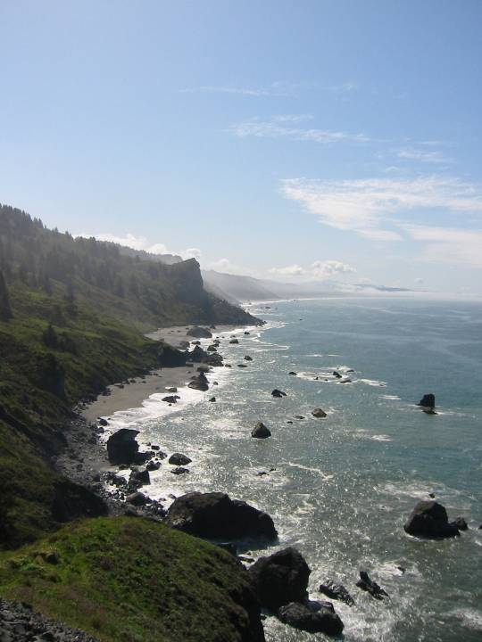
Mélange knockers become stacks
Notes:
Knockers are also resistant to wave erosion and so become stacks.

Slide 11
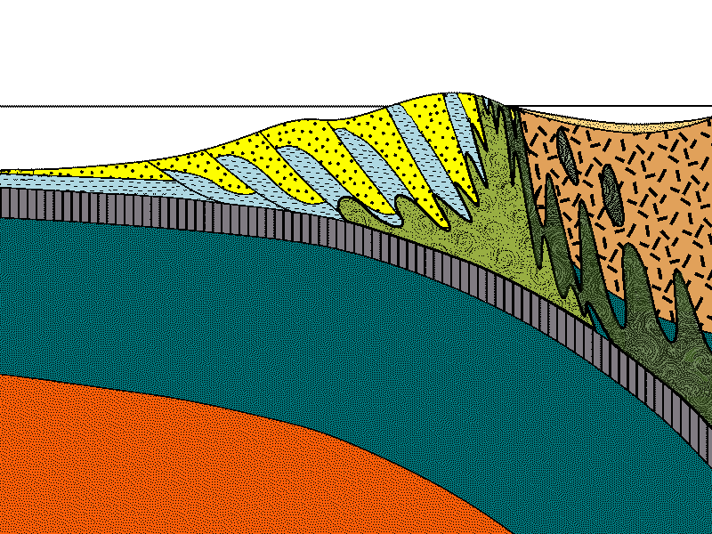
Mélange
Notes:
Mélange is uncommon in Olympic National Park, because mélange is formed in the deeper parts of accretionary wedges and the Olympic wedge is just too young to have formed much mélange, let alone uplift and expose it.

Slide 12
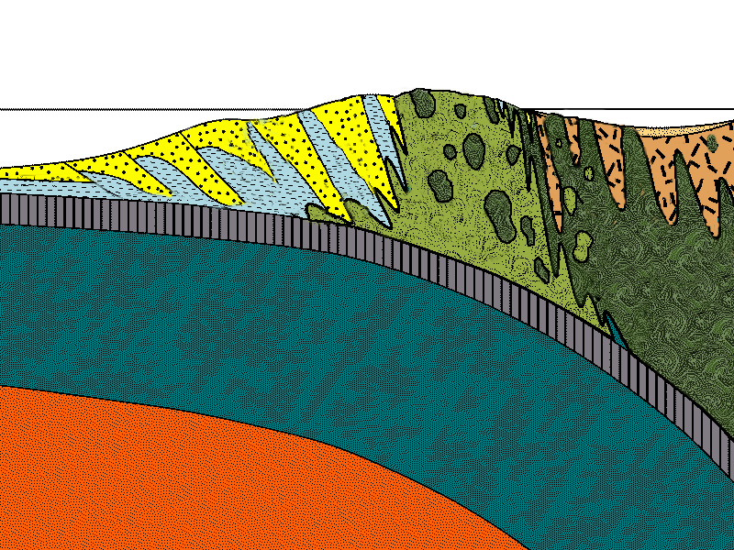
Mélange
Serpentinite
Notes:
But the Franciscan accretionary wedge was active for perhaps 100 million years, which is ample time to not only form lots of mélange and serpentinite, …

Slide 13
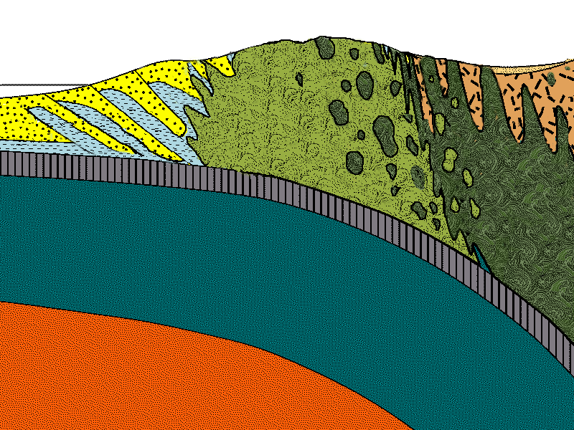
Notes:
… but also to uplift, ….

Slide 14
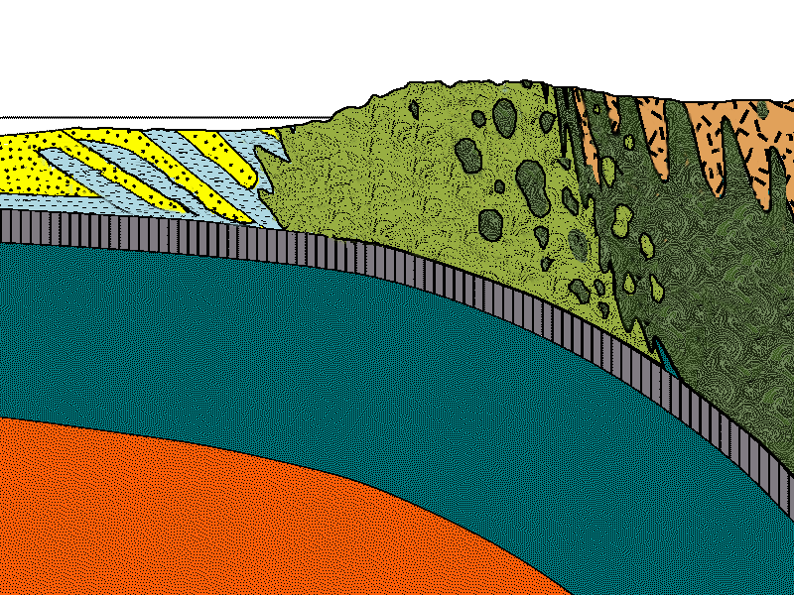
Notes:
… and expose much of these rocks by erosion.

Slide 15
Franciscan Mélange
Terrigenous Sediment
Biogenous Sediment
Oceanic Crust / Mantle
Notes:
The Franciscan mélange is composed of three primary components. First let’s take a look at terrigenous sediment – the sediment which is derived from sources on land.

Slide 16
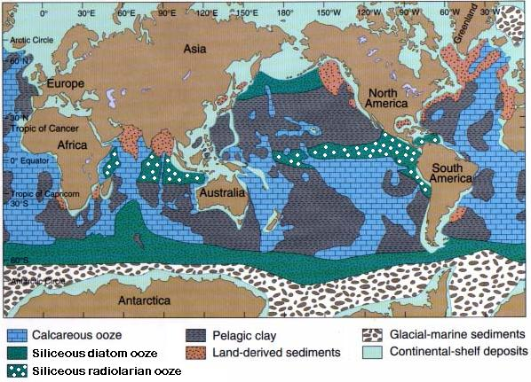
Notes:
This map shows the distribution of various sea floor sediment types. There are three kinds of terrigenous sediment shown on the map that end up in the Franciscan Complex. First are the continental shelf deposits, shown in light blue, which are represented by sandstone and mudstone in the Franciscan Complex. Next, the red stippled pattern is mostly turbidite. And finally the dashed, dark blue regions are pelagic clay, which you should remember is derived from dust blown out to sea. Except for pelagic clay, terrigenous sediment generally deposits close to land, and it forms the greatest sediment thicknesses.

Slide 17
Notes:
Sediment thickness is shown here in brighter colors. Not surprisingly the thickest sediments occur near land, especially at the mouth of major rivers. This is the type of material that will comprise the bulk of an accretionary wedge and most of that will be some kind of sandstone.

Slide 18
Mélange
Notes:
But remember that accretionary wedge material is carried to some depth along the subduction zone before it gets uplifted to the surface.

Slide 19
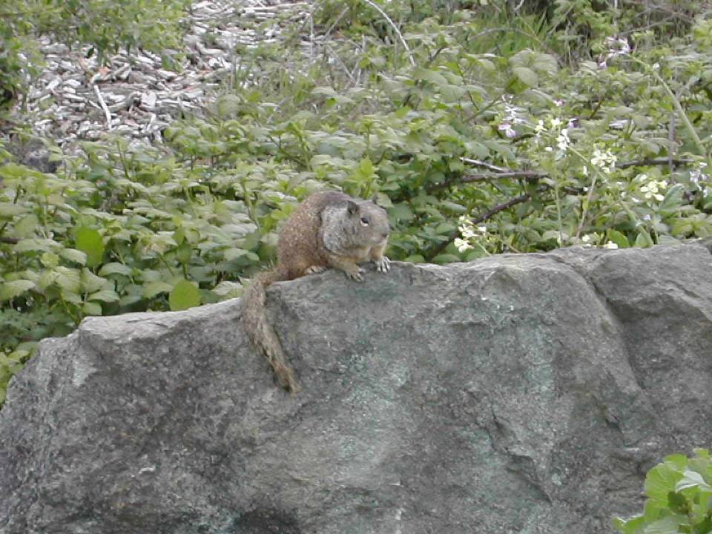
Aahhh… feels like Cretaceous meta-sandstone!
Notes:
Thus these rocks will be metamorphosed to some degree. Note the greenish colors on this Cretaceous meta-sandstone from Redwood National Park. At low metamorphic grades the dark, ferromagnesian minerals will typically rearrange their atoms into various green metamorphic minerals like chlorite, epidote and actinolite.

Slide 20
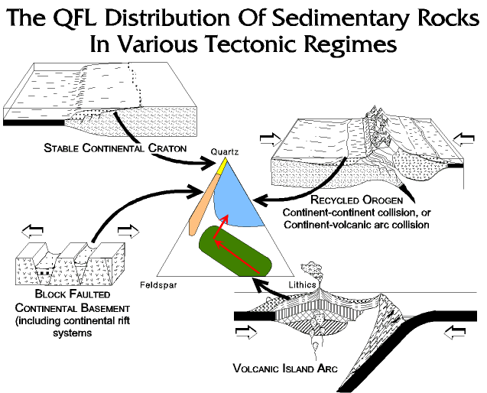
Notes:
The sandstones in the Franciscan Complex contain a fair amount of ferromagnesian minerals too, because unlike the mature, reworked, quartz-rich sandstone of divergent continental margins, most of the Franciscan sediments where derived from active volcanic arcs and thus deposited too rapidly for weathering to reach completion. Sandstones in the Franciscan Complex typically contain a lot of sand-sized rock fragments (lithics) with a silt and clay matrix and are called greywackes.

Slide 21
Wacky?! Who you calling wacky?
Meta-greywacke
Notes:
So this sandstone is more specifically a meta-greywacke. The prefix “meta” implies some metamorphism has taken place, but the original texture of the parent rock is maintained.

Slide 22
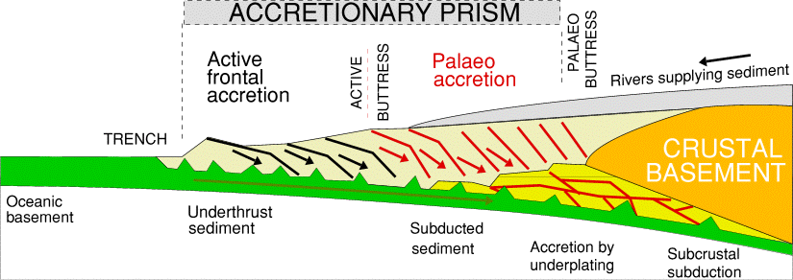
H₂0
Notes:
Remember that water gets sweated out of the subducted oceanic plate as it encounters higher temperatures and pressures deeper in the subduction zone. Since the Franciscan wedge was active roughly 5 times longer than the Olympic wedge, far more hot, pressurized water from the subducted plate migrated into the sediments of the accretionary wedge.

Slide 23
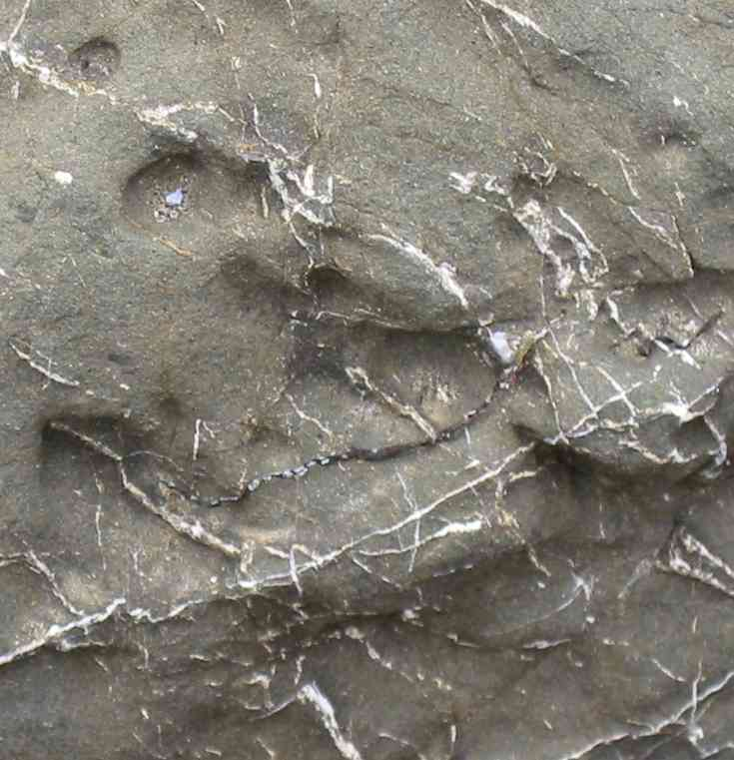
Quartz veining in greywacke
Notes:
Thus much more silica was dissolved from silica-bearing sediments at depth and reprecipitated as quartz veins near the surface.

Slide 24
Franciscan Mélange
Terrigenous Sediment
Biogenous Sediment
Oceanic Crust / Mantle
Notes:
Although not as abundant as the terrigenous component, biologically derived sediment has, I think, a more fascinating history.

Slide 25
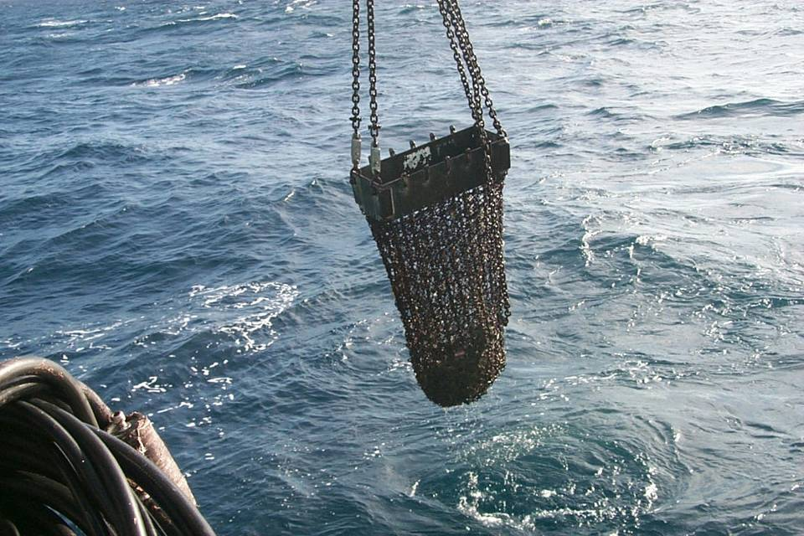
Dredge haul off Nicaragua
Notes:
Let’s take a look at what a typical deep-sea dredge haul would contain. Notice that fine sediment would pass through the coarse chain-link mesh at the end of the dredge.

Slide 26
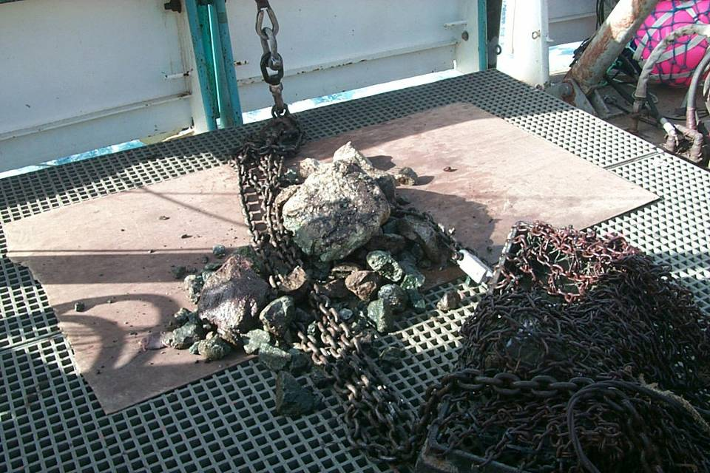
Wedgie Wannabes
Limestone
Red Chert
Greenstone (basalt)
Notes:
So what remains are chunks of oceanic crust and hardened sediment. Typically the basalt is altered into a low-grade metamorphic rock called greenstone, and the hardened sediment is chert and limestone.

Slide 27
Notes:
This type of limestone forms from a type of open ocean sediment known as calcareous ooze, shown here with the brick-like pattern.

Slide 28
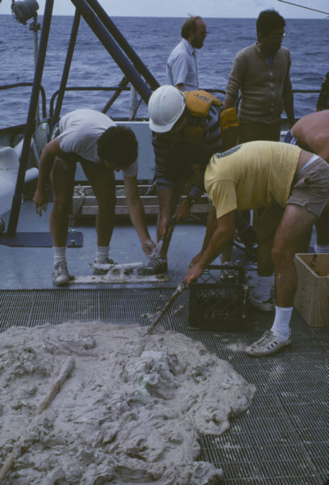
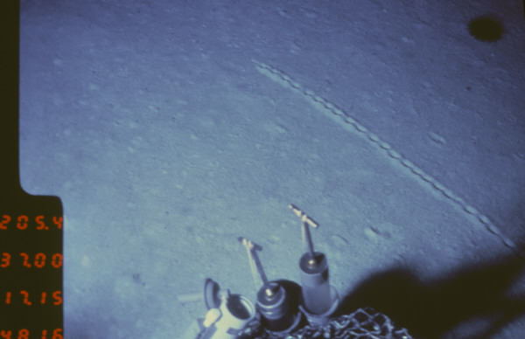
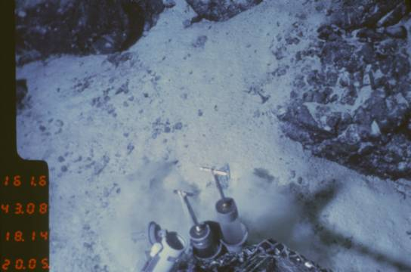
Calcareous ooze
Notes:
Calcareous ooze is made of countless plankton shells composed of calcium carbonate. The name derives from the soupy consistency that the mass of tiny shells takes on. The two photos on the right were taken from a submersible – the top one showing some kind of animal track left in the soft ooze and the bottom one showing ooze partially covering basalt. All of these photos show nearly pure calcareous ooze, which is relatively rare because ooze usually deposits together with some pelagic clay.

Slide 29
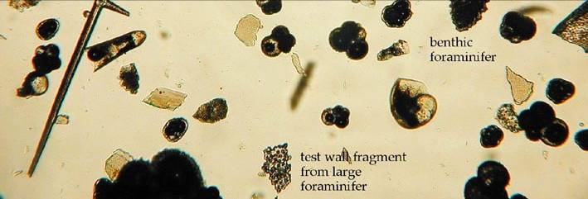
Mostly calcareous ooze
Calcium Carbonate Compensation Depth (CCCD)
Mostly clay
Notes:
In fact, below a certain depth, know as the calcium carbonate compensation depth (CCCD), clay is pretty much the only sediment that lands on the bottom because calcareous shells tend to dissolve as they sink. What dissolves calcium carbonate in the ocean is mostly carbonic acid which forms from the chemical combining of carbon dioxide with water. Where there is more CO2 there is more carbonic acid and shells dissolve faster. At depth, the colder temperatures and higher pressures both contribute to high levels of CO2 and carbonic acid so shells dissolve faster. Above the CCCD, there is little carbonic acid so shells dissolve slowly and calcareous ooze can deposit. At the CCCD, the rate at which shells dissolve is exactly equal to the rate at which they fall from above

Slide 30
Notes:
So what does all this mean for the Franciscan Complex? Well for one it means that any limestone formed from calcareous ooze was probably brought to the accretionary wedge atop sea mounts which would have been shallow enough to be above the CCCD.

Slide 31
calcareous ooze
Notes:
You can see this pattern in the present distribution of calcareous ooze, which in the Northern Pacific is mostly restricted to the relatively shallow areas atop the Hawaiian-Emperor seamount chain. If the ocean sediment distribution during the late Jurassic and Cretaceous when the Franciscan Complex formed was at all similar to today’s pattern, you can see why limestone is not an especially common rock type in the Franciscan.

Slide 32
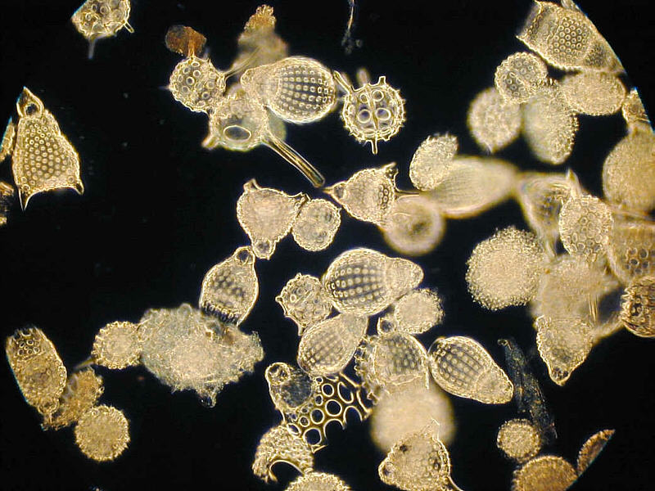
Radiolarians
Notes:
On the other hand, there is a fair amount of chert in the Franciscan. Chert forms from siliceous ooze – in this case made from countless silica-shelled, planktonic animals called Radiolarians. Made of silica, these shells do not dissolve as they settle to the bottom, but because they need relatively high nutrient levels to flourish, …

Slide 33
Siliceous radiolarian ooze
Notes:
… siliceous radiolarian ooze tends to form where equatorial upwelling brings ample nutrients to the surface. Now you might be thinking at this point: How did equatorial sediments get to Redwood National Park? Well this is where it gets interesting!

Slide 34
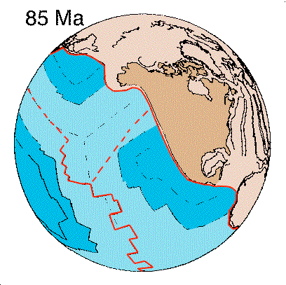
radiolarian ooze
Notes:
Notice that a point near the equator would follow a more-or-less northeast trajectory toward the Franciscan wedge where any carried-along sediment would get accreted!

Slide 35
Siliceous radiolarian ooze
Notes:
The abundance of siliceous ooze near the equator is clearly seen in the seafloor sediment thickness map.

Slide 36
Radiolarian “rain”
Notes:
Franciscan sediments where derived from ocean floor that largely passed through this region where radiolarian shells rained down on upon it.

Slide 37
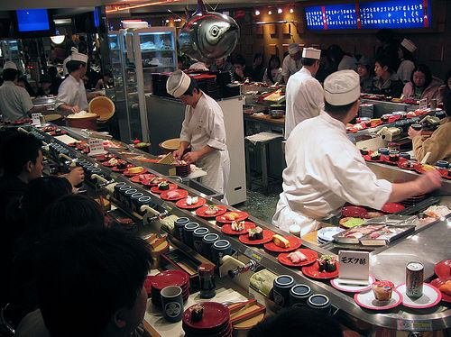
Stupid siliceous ooze! So hard to roll.
Notes:
Like some gigantic slow moving sushi train …

Slide 38
Notes:
… the subducted ocean plate brought a diverse assortment of sediments to the wedge with chert formed from siliceous radiolarian ooze below the CCCD.

Slide 39
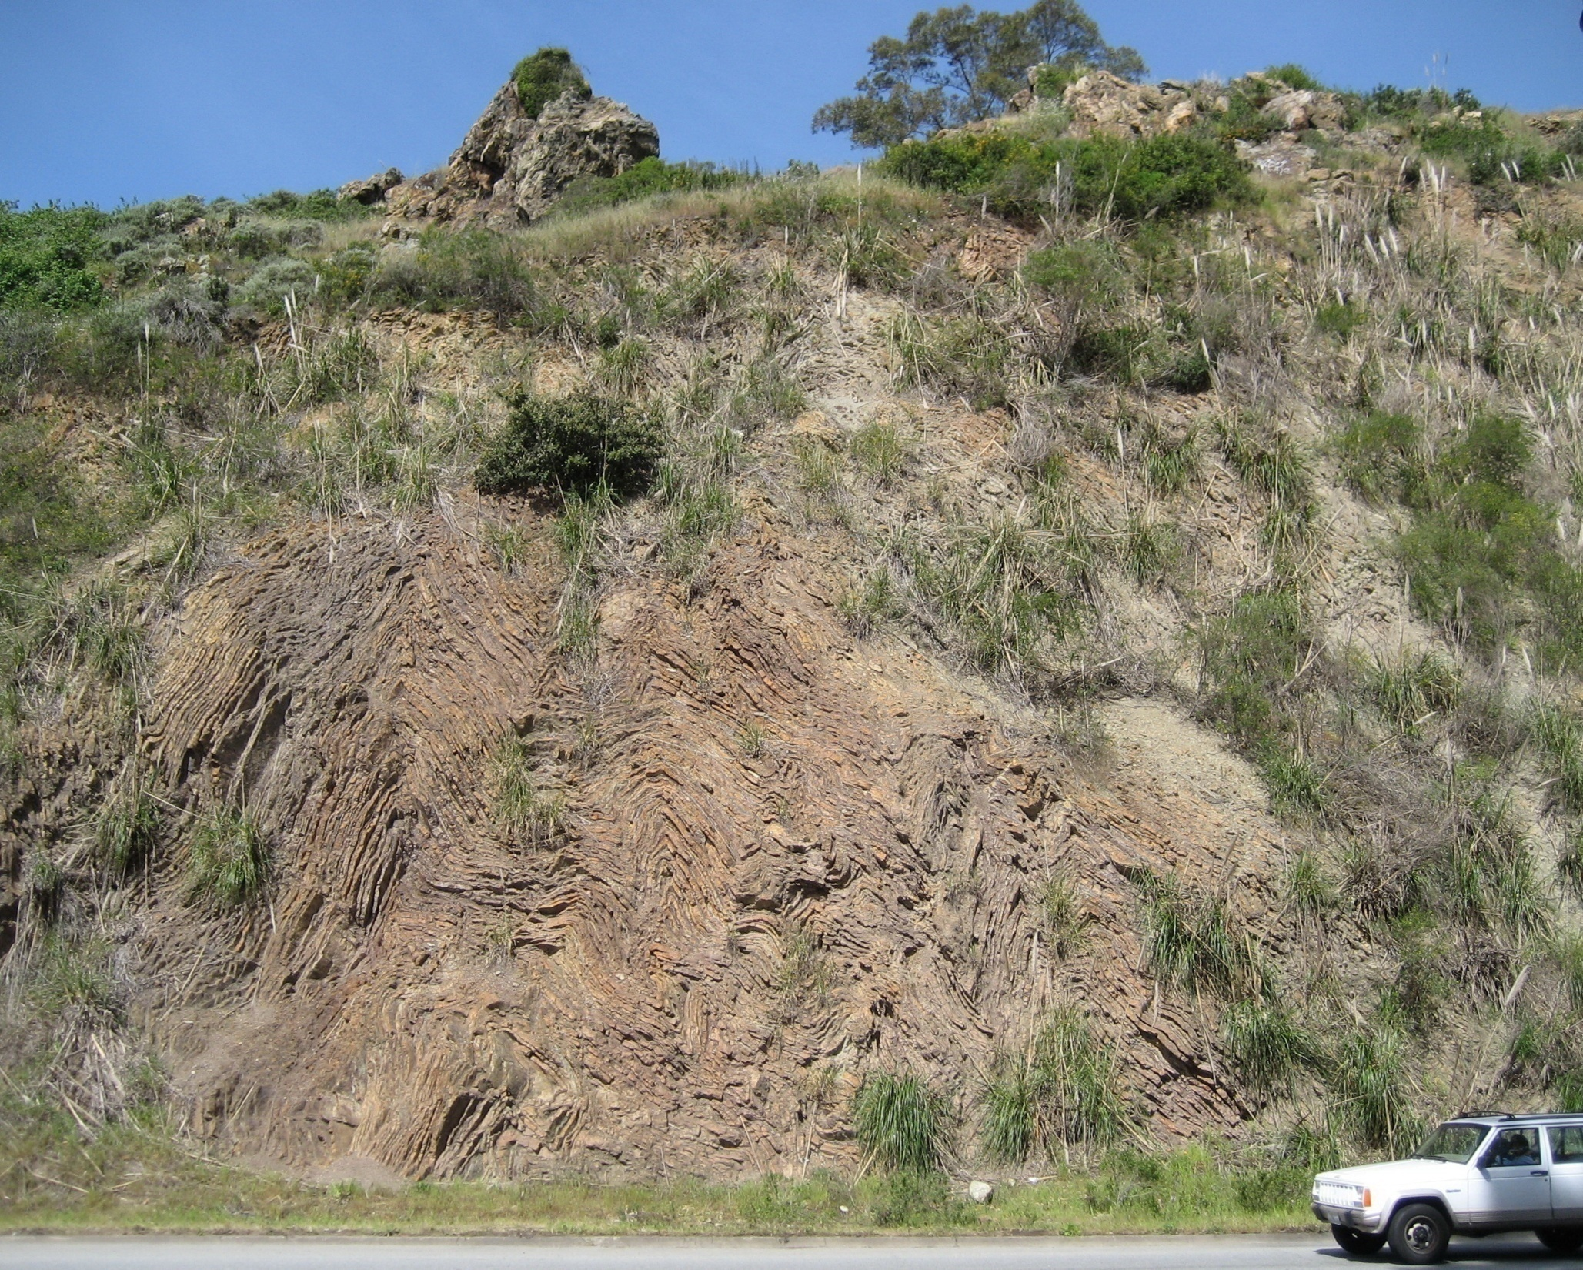
Notes:
When smashed against the accretionary wedge chert typically becomes folded.

Slide 40
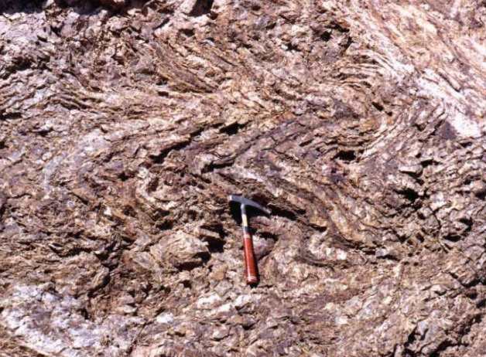
Folded Red Chert (Radiolarian)
Notes:
The layering is due to varying amounts of pelagic clay (now shale) deposited with the ooze.

Slide 41
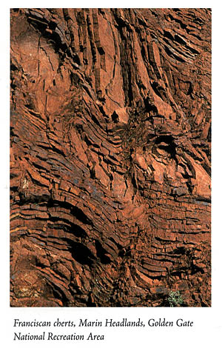
Notes:
Franciscan chert is typically red or brown. This is due to the presence of iron oxide derived from meteorite dust that was incorporated into siliceous ooze because it deposits at such a slow rate that appreciable amounts of cosmogenous sediment can accumulate.

Slide 42
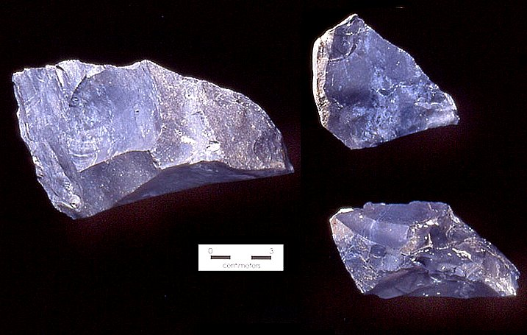
Black chert (organic rich)
Notes:
Black chert is fairly common as well, and indicates the presence of carbon from organic matter that settled in deep oxygen-less basins where aerobic decay could not take place.

Slide 43
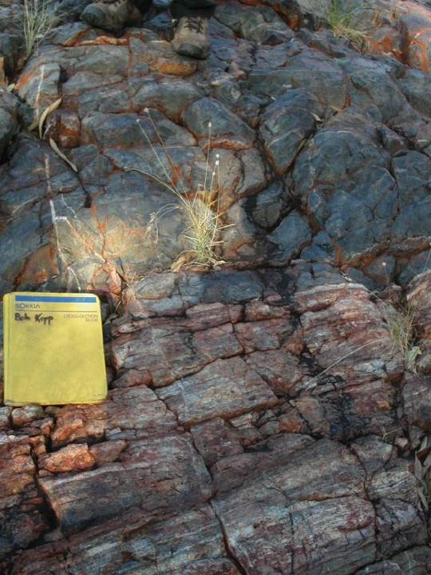
Notes:
Here we see both red and black chert in the same outcrop.

Slide 44
Franciscan Mélange
Terrigneous Sediment
Pelagic Sediment
Oceanic Crust / Mantle
Notes:
Lastly, great masses of oceanic crust also get scraped off and incorporated into the accretionary wedge as well as haphazard chunks of altered mantle.

Slide 45
Notes:
This generally happens when seamounts are scraped of at the wedge.

Slide 46
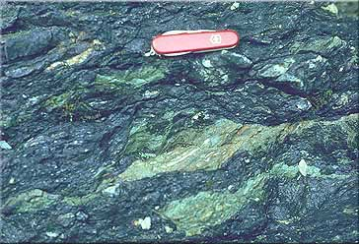
Mélange close-up
Argillite (clay shale)
Greenstone (basalt)
Sandstone
Notes:
In this close-up of a typical Franciscan mélange, we see fragments of greenstone, sandstone, and other rocks in disrupted argillite, which is a clay-rich shale probably derived from pelagic clay. The basalt has been metamorphosed into greenstone, whereas the sandstone, containing more of the metamorphism-resistant minerals quartz and feldspar, is little affected.

Slide 47
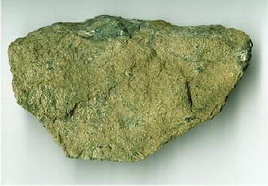
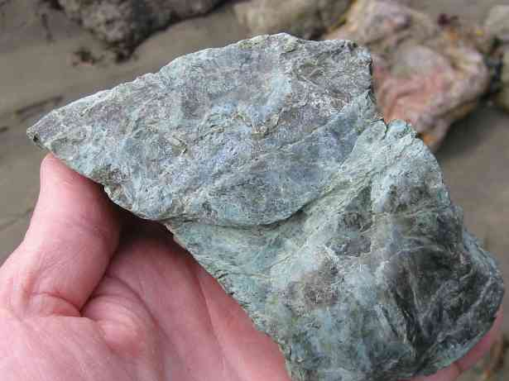
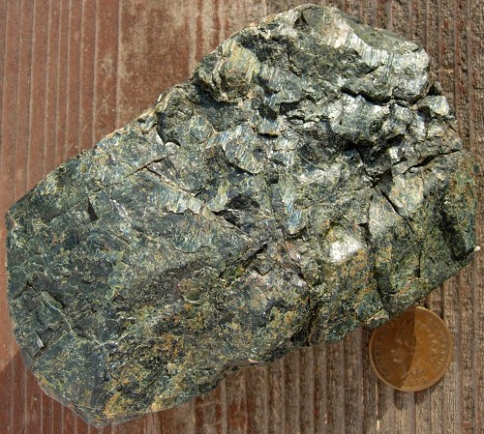
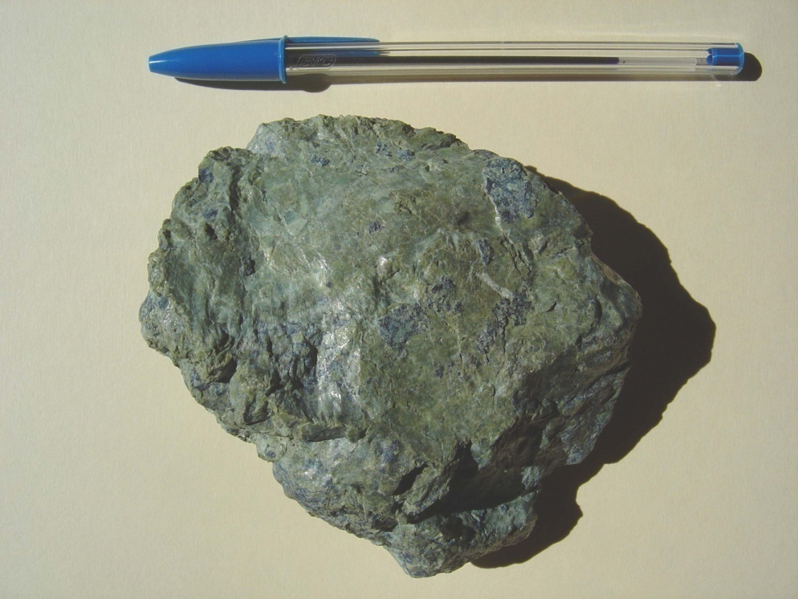
Notes:
Another rock type that typically occurs in the Franciscan mélange is serpentinite. This variously green rock is named after its smooth, snake-skin-like feel and forms from basalt or mantle rocks altered by hot, pressurized water. There are two places where serpentinite can form and later be incorporated into a wedge.

Slide 48
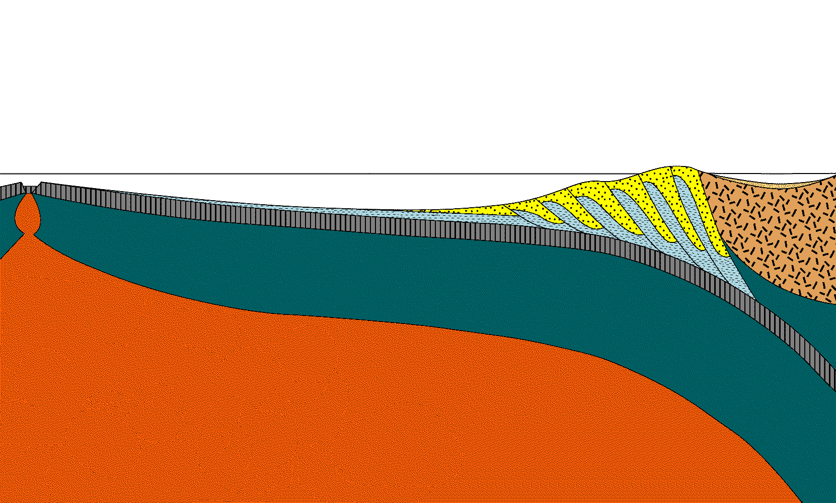
Hot springs
Notes:
First, hot spring systems near the ocean ridge can form serpentinite from either the basalt or lithospheric mantle there.

Slide 49
H₂O
Notes:
Second, serpentinite can also form due to the water sweated out of the subducted plate into the wedge of lithospheric mantle above it.

Slide 50
Serpentinite
Notes:
Serpentinite created in this way is under-thrusted by, and mixed with mélange rocks ...

Slide 51
Notes:
... all of which are ultimately worked to the surface …

Slide 52
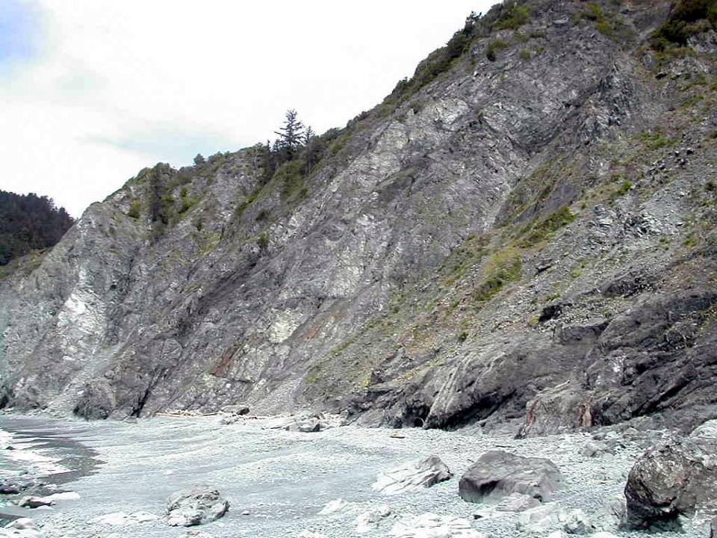
Mélange in Redwood National Park
Notes:
… where, perhaps in a sea cliff, those with some understanding of geology, can reflect on the odyssey that brought these rocks here and feel the awe of time.

Slide 53
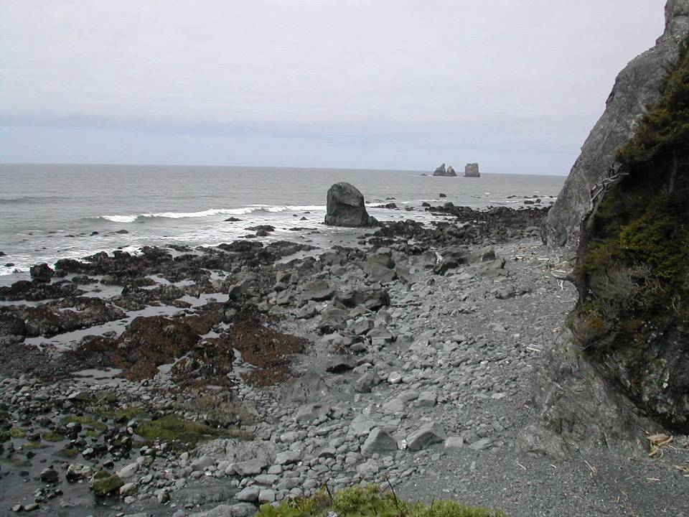
Notes:
The wonderful thing about being a geologist is that we see with the added dimension of time.

Slide 54
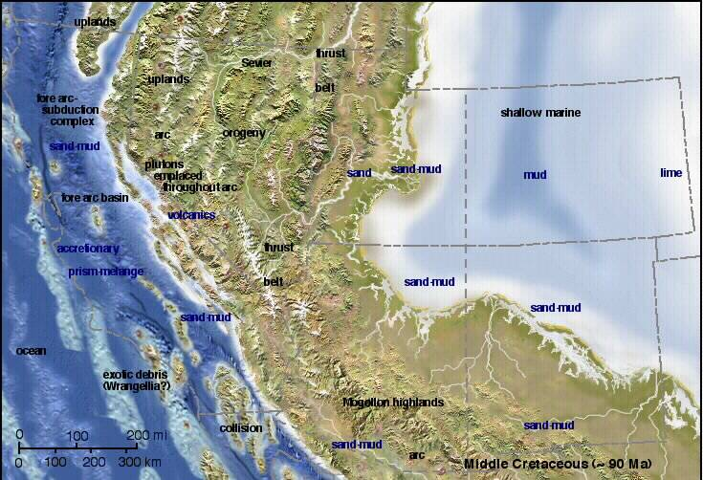
Klamath Terrain
Middle Cretaceous (~90 Ma)

Slide 55
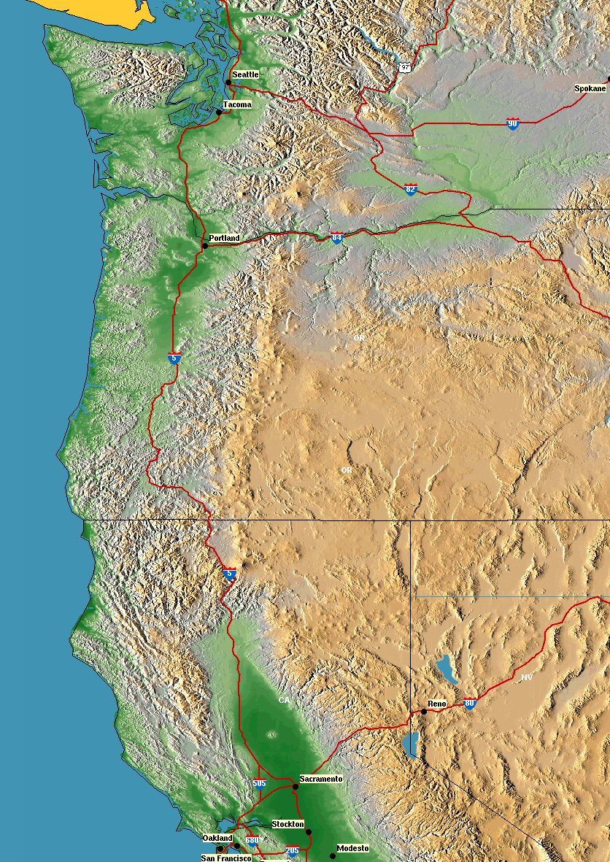

Slide 56
Klamath?
Mélange

